Slide 1
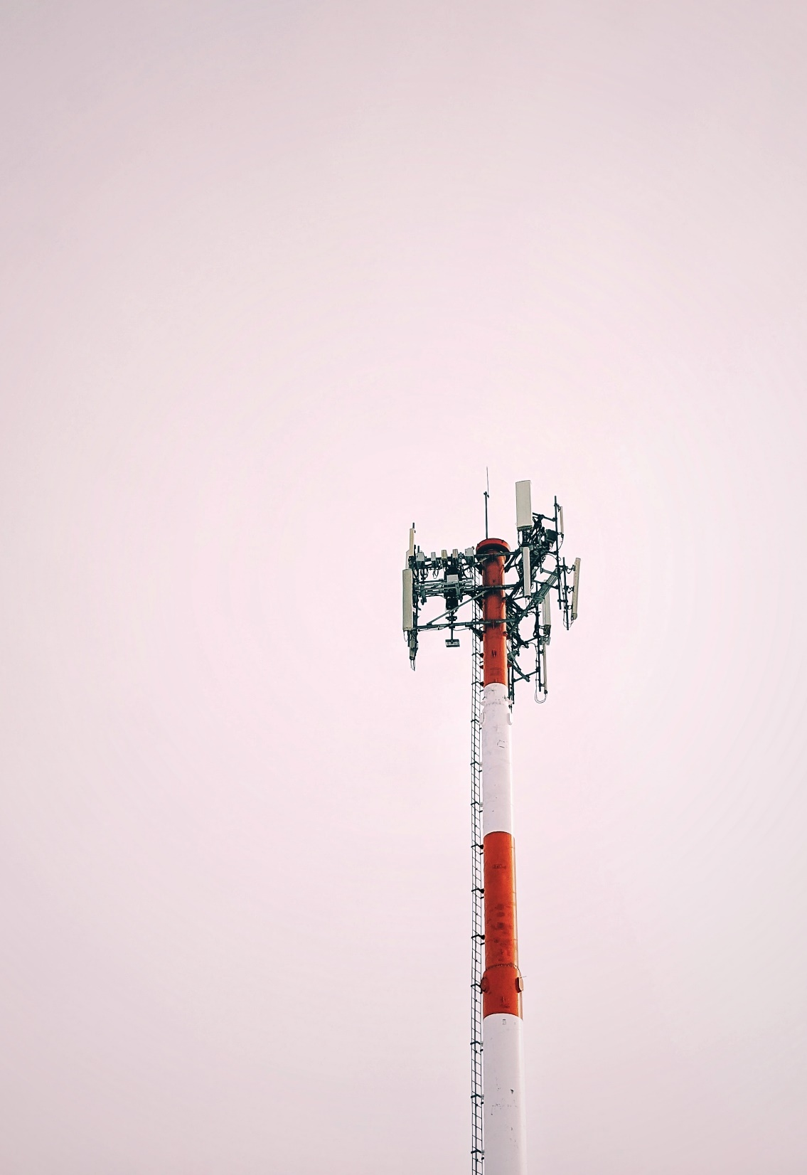
Uses of Diode & its Practical Application in Real Life
Submitted to- Submitted by-
MD RABIUL ISLAM MOST JANNATUL FERDOUS UMAMA
ID: 20-42616-1

Slide 2
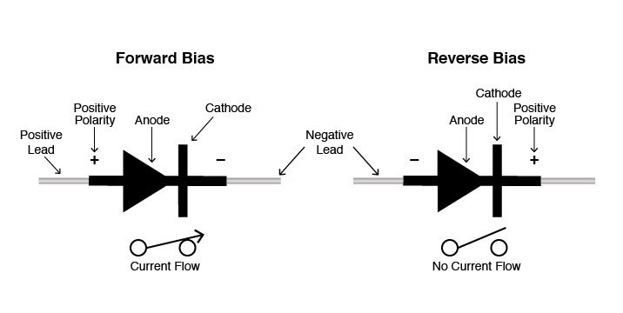
What is Diode?
Two-terminal electronic component
Zero resistance in one direction
infinite resistance in the reverse direction
Symbol of Diode-
Arrowhead points in the direction of conventional current flow in the forward biased condition
Anode is connected to the p side and the cathode is connected to the n side

Slide 3
Types of Diodes
Zener Diode
PN Junction Diode
Tunnel Diode
Varactor Diode
Schottky Diode
Photo Diode
PIN Diode
Laser Diode
Avalanche diode
Light emitting diode

Slide 4
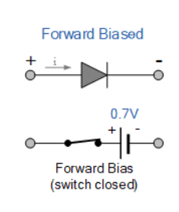
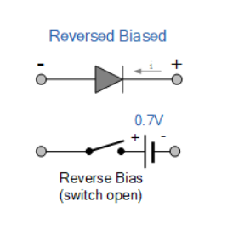
Forward Biased Diode
positive terminal of a source is connected to the p-type side of the diode
negative terminal of the source is connected to the n-type side of the diode
no current flowing through the diode in the beginning
Reverse Biased Diode
Negative terminal of the voltage source to the p-type side of the diode
positive terminal of the voltage source to the n-type side of the diode
some free electrons in the p-type semiconductor and some holes in the n-type semiconductor

Slide 5
Controlling the size of a signal
Diodes and light
Light emission
over voltage protections
Uses of Diodes in Everyday Life
Diodes in clamping circuits
Rectifying a voltage/ power conversion
Isolating signals from a supply
Logic gates
Diodes in solar panels
Voltage multiplier circuits

Slide 6
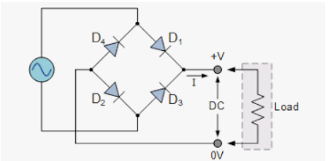
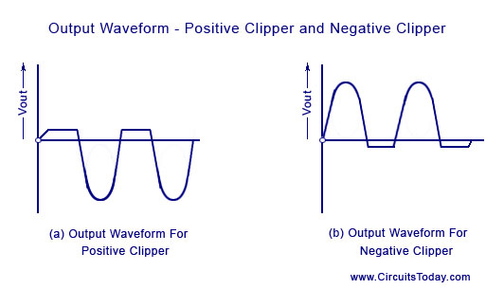
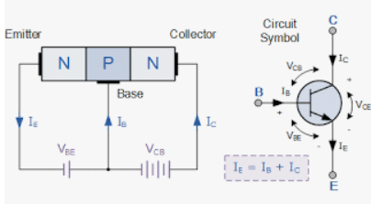
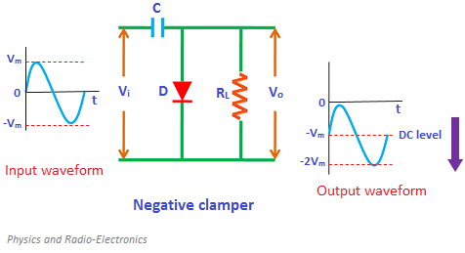
Most Applications of Diodes
Rectifier
Transistor
Waveform Clipper
Clamper

Slide 7
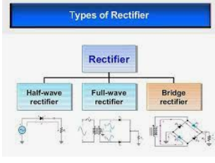
Rectifier
Convert DC to AC
Change the voltage using a transformer
Convert AC back to DC using a rectifier
Three type of Rectifier
Half wave rectifier
Full wave rectifier
Bridge rectifier

Slide 8
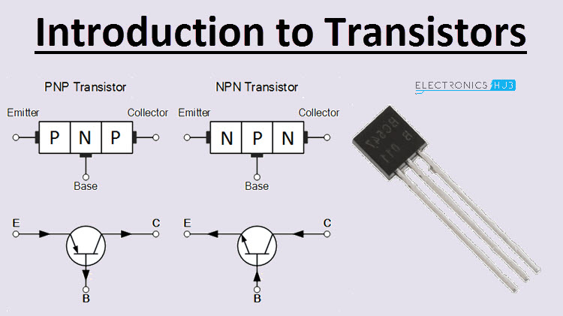
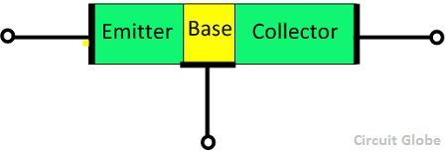
Transistor
Semiconductor Device
transfer property and resistance property
Transistor Terminals
Emitter
Base
Collector

Slide 9
Waveform Clipper
Linear and nonlinear elements
Resistors
Transistors
clippers are classified into two types:
Series Clippers
Shunt Clippers.
Clamper
DC restorers
Level shifters
positive or negative peak of a signal can be positioned
classified as clamper
positive
negative

Slide 10


